Slide 1


SAP UI5 & FIORI with OData TRAINING
Anubhav Oberoy & Shekhar Vedi
Day – 29

Slide 2

Agenda – Day 29
BOPF
Why we need it?
Use case – end to end Fiori app which can insert/update/ delete data in sap

Slide 3

Can CDS be used to insert data in SAP tables?
CDS view is a view, a view cannot be used to insert data into the system. But we have frameworks provided by SAP which can leverage CDS as business object and then we can perform CRUD on DB tables.
BOPF
Business Object processing framework
2008
CDS-BOPF
1909
RAP – Restful Application programming model
40 H

Slide 4









BOPF – Business Object processing framework
Petrol
Business Object
Car
BOPF Framework
This framework tries to unify our ABAP development. Brings standardization and reduce redundancies. What we need is a business object to be shared with BOPF.
speed

Slide 5
Business object
An SAP Real world entity (database table, Group of dependent data base tables)
It is represented as a TREE composition
CDS view will represent our business object
SAP provides new annotations to make a CDS view work like a BO and surrenders it to BOPF framework
This BOPF framework will automatically develops the logic for CURD
SO Header
SO Items
1..*

Slide 6
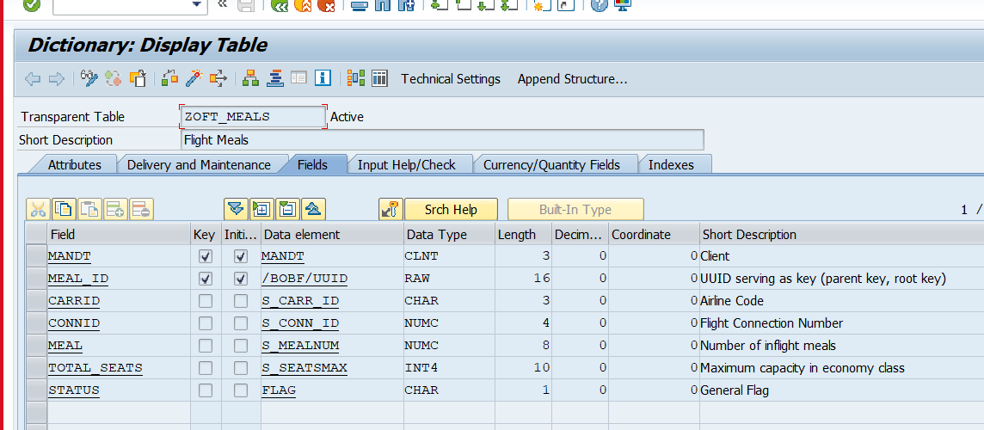
Use case
Covid 19 hit hard every sector. The most hit sectors are hospitality and aviation sector. We have use case from aviation sector where we have the delivery of in-flight meals to be done in contact less manner.
The requirement is to design a FIORI app which can be used by food manager to organize the in-flight meal from his tablet.
The design goals are as below
Display all the flights, filter them by airline code
Create new flight entries in system
Update flight status and assign meal to the flights
There will also be an approval by supervisor to inflight meal
The crew can check the meal status and approval status online on same app and picks it from store

Slide 7
Title
https://help.sap.com/docs/SAP_NETWEAVER_750/cc0c305d2fab47bd808adcad3ca7ee9d/f8af07bb0770414bb38a25cae29a12e9.html?version=7.5.9

Slide 8
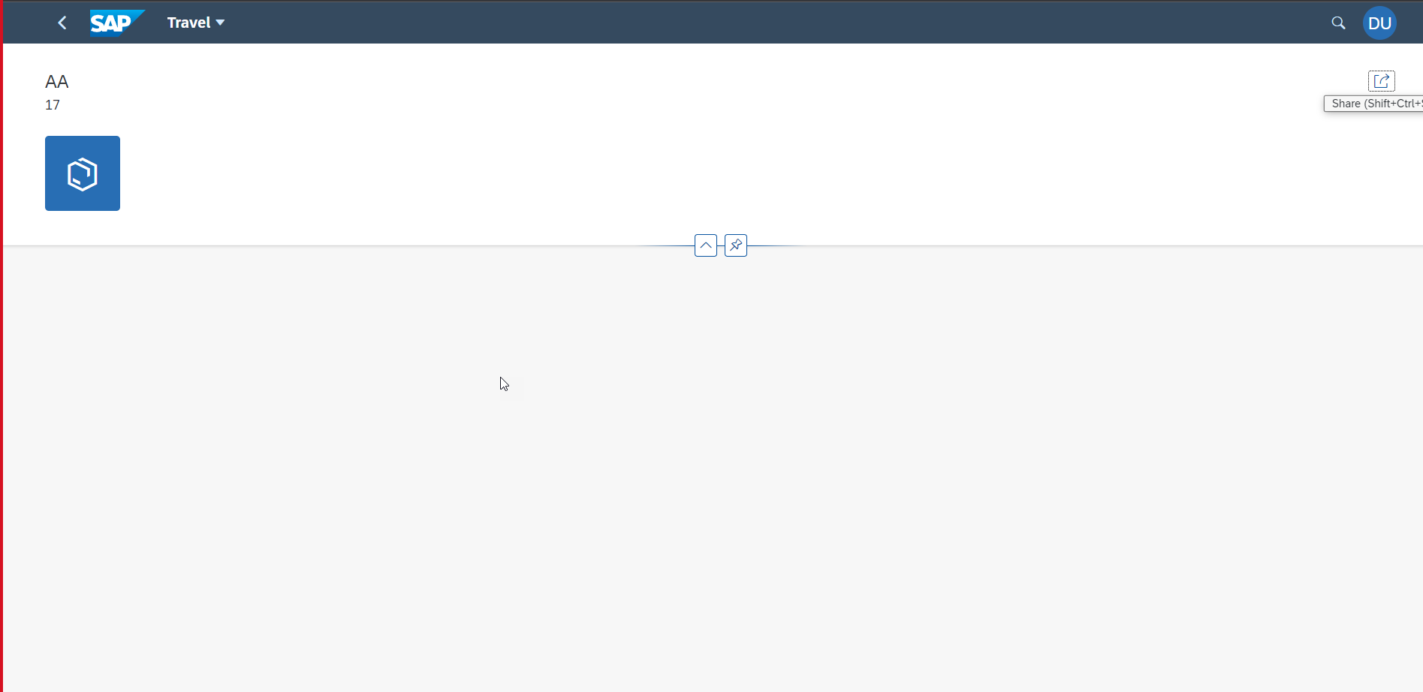



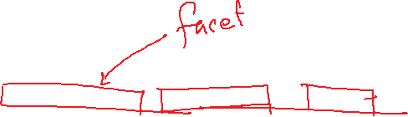

Title
<Content>

Slide 9
Title
User
Fiori App
OData
BOPF Framework
DB Table

Slide 10
Title
<Content>
EDIDC
40000050 1
Some ERP
SAP ERP 2005
ECC
S/4HANA
2021
IDoc
EDIDS – STATUS RECORD
DNO COUNTR STAMID STMNO
1 1 ABC 500 Z
1 2 ABC 500 Z
1 3 DEF 200 Y
1 4 WER 300 X

Slide 11
Title
<Content>
ZHPC_XX_C_IDOC_DB
ZHPC_XX_CO_IDOC
ZHPC_XX_MAX_STATUS
ZHPC_XX_MAX_C
EDIDC
EDIDS

Slide 12

End of Day 29

Slide 13

Questions

Slide 14

Anubhav Oberoy

Slide 15


We’re committed to empower you to be
Most Desirable Resource
through powerful training solutions.
We build the workforce of the future.
290+
Corporate Clients
30,000+
Learners Trained
29000+
Learners Placed
FREE WEBINARS
Sign up for free webinars with industry experts every fortnight!
Enroll Now!
Contact us today!
https://anubhavtrainings.com/

Slide 16




More from AnubhavTrainings.com

Slide 17
Title
Content

